Slide 1
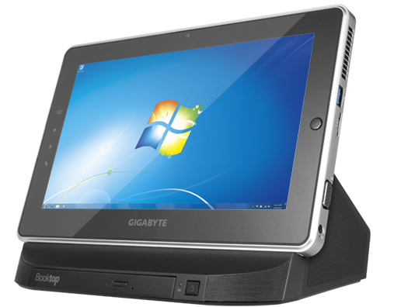
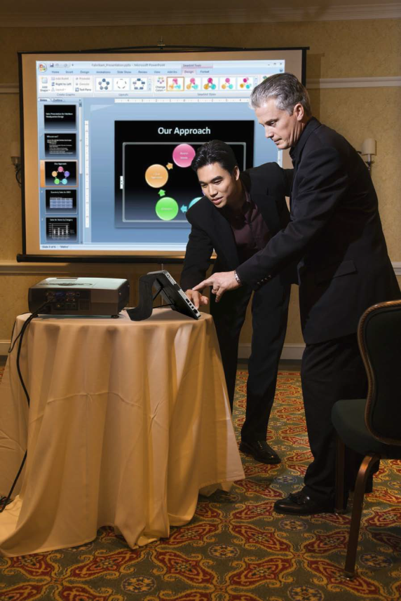
E-Slate Tablet PC
Born to be Learning,
Working, Presentation
& to Go
Special price for
September 2011
S1080 E-Slate
CPU Intel® Atom™ Dual Core N570 (1.66GHz)
OS Genuine Windows® 7 Home Premium
LCD 10.1” Capacitive Multi-touch Panel
1024x600 with LED backlight
Memory 2GB DDRIlI
Video Graphics Intel® GMA 3150
Hard Disk Drive 320 GB 2.5” SATA 5400rpm
I/O Port USB (3.0)*1, USB (2.0)*1, SD Card Reader
Audio 1.5 Watt Speaker*2, Internal Microphone
LAN 10/100/1000Mbps Ethernet
WLAN 802.11b/g/n Wireless
Bluetooth v3.0 + HS
3.5 G 3.5G supported (Optional)
Webcam 1.3 MegaPixel
Battery Li-polymer, 4000mAh, 7.4V
Dimensions 270(W) x 173(D) x 14.94(H) mm
Weight 895g (w/ main battery)
15,900.-
free VAT

Slide 2
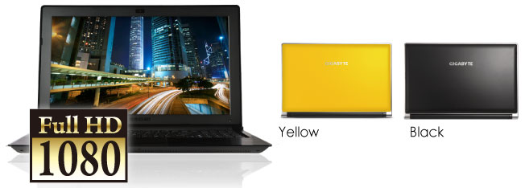
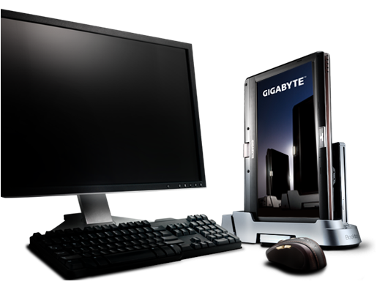
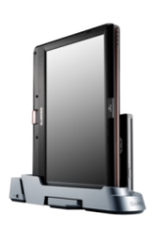
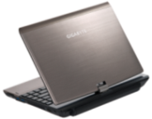
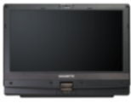
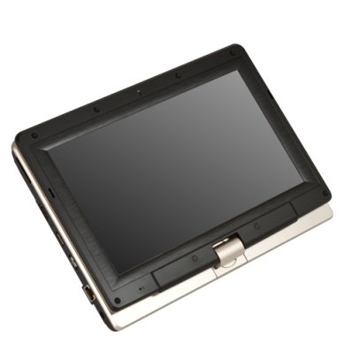
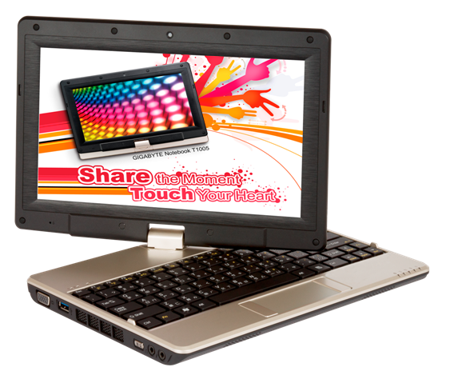
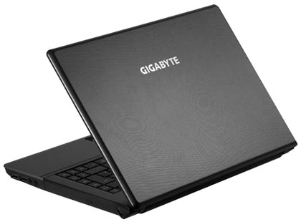
15.6’’ Notebook
P2532
Intel® Core™ i7-2630QM Processor
( 2.0 GHz - 2.9 GHz)
Genuine Windows® 7 Home Premium
15.6" Full HD 1920X1080 LED backlight
NVIDIA® GeForce® GT550M 2GB
4GB DDRIII, 2 slots (Max 8GB)
500GB 2.5" 9.5mm SATA HDD 7200rpm
BT3.0 / 1.3 MegaPixel / ~2.6kg (w/ODD and 6-cell battery)
34,900.- FREE VAT.
T1125
Special promotion for T1125N Smart Booktop PC FREE
Docking + slot-in DVD- Super Multi Dual-Layer Drive
at price 4,500.- - Handy Bag at price 1,500.- limited gift only in September 2011 **Total Value 6,000.-**
11.6’’ Booktop Notebook
Intel® Core™ i5 Processor
Genuine Windows® 7 Home Premium
11.6'' Capacitive Multi-touch Panel 1366x768
NVIDIA® GeForce® 410M DDRIII 1G
4GB DDRIII, 2 slots (Max 8GB)
500GB 2.5"9.5mm SATA HDD
BT2.1 / 3.5G Antenna built-in / 1.3 MegaPixel
~1.73Kg (w/ 6-cell battery)
32,900.-
FREE VAT.
Q2432A
17,013.-
FREE VAT.
Intel® Core™ i5-2410M
Processor 2.3GHz
14" 1366x768 LED backlight
AMD Radeon™ HD6730M 1GB
4GB DDRIII, 2 slots (Max 8GB)
640GB 2.5" 9.5mm SATA HDD 5400rpm
BT3.0 / 1.3 MegaPixel
~2.2kg (w/ODD and 6-cell battery)
T1005
19,153.-
FREE VAT.
Q2532M
Touch Your Heart!
Intel® Core™ i3-2330M
Processor 2.2GHz
14" 1366x768 LED
4GB 2 slots (Max 8GB)
500GB 2.5" 9.5mm SATA HDD
BT3.0 / 1.3 MegaPixel
~2.2kg(w/ODD and 6-cell battery)
Intel® Atom™ Dual Core Processor
N570 (1.66GHz)
10.1” Capacitive, Resistive Multi-touch Panel 1366x768 LED backlight
2GB DDRIII 1 slot (Max 2GB) 320 GB 2.5" 9.5mm SATA HDD /BT2.1/3.5G Antenna built-in/1.3 MegaPixel/~ 1.48Kg (w/ 6-cell battery)
17,013.-
FREE VAT.
www.gigabyte.com
The Assist Hot Line : 0816237555

